Slide 1

Azul Connect E̵̬̎r̴̞͘r̴̢̕o̸̠͐r̴͋͜ ̷̦̓4̸̘̓0̶̭̐4̷͕͂

Slide 2
Problem
Lack of Ideas: Many ideas are never shared, and can never improve the community
Lack of Connections: Many ideas that are present lack widespread advertising, and don’t reach all interested people
Talent & Ability: No one person can accomplish all projects on their own, limiting the scope of ideas
Freedom: The more common University-sponsored projects have relatively rigid requirements, which can prevent creative solutions

Slide 3
Project Vision
Connect creative individuals with groups that can enact dreams
Allow innovation by promoting the public view of project ideas
Provide an opportunity for the community to engage & improve with applied experience on projects

Slide 4

Product Overview

Slide 5
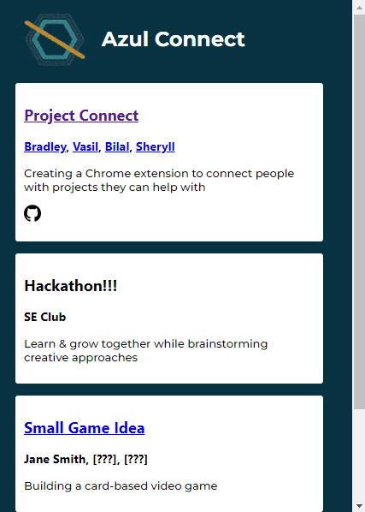
Key Features
Open Forum: All members are encouraged to share their project ideas
Ease-of-Use: Extension has a simple interface with a clean and easy-to-use design
Access to Resources: The main contributors already on the project and links to project resources are present
Messaging: (TBD) Allows prospective project participants to connect with project members before joining

Slide 6
Technologies
HTML/CSS-based extension
Document-style database (e.g. MongoDB)
Linked internal/external platform for communication
That’s all! Lightweight = Easier to implement

Slide 7
Security Considerations
Database is storing limited sensitive data
Users can be authenticated by logging into the browser
For stored data, accessed through group logins with limited priveledges

Slide 8
Automation & Sustainability
HTML/CSS-based extension, no computationally-intensive frameworks
In future development, database system is something that could be installed easily, then connected through the extension

Slide 9
Innovation
Targets a unique niche not served by communities on other platforms
Think EagleLink, Reddit, etc.
Connection sparks innovation, more projects mean more good ideas flow

Slide 10
Design Consideration
Extension built with HTML/CSS, with the option to extend functionality with JavaScript
Viewing project information in a simple way allows users to sort through them faster
Simplistic design = easy to modify

Slide 11

Moving On
Figma: Stylized Prototype

